Slide 1
System Theory
Ronald E. Giachetti, Ph.D.
Associate Professor
Industrial and Systems Engineering, FIU

Slide 2
Overview
Describe how an enterprise fits the definition of a system
Contrast reductionist thinking with systems thinking
Apply systems thinking to understand and solve problems
Create a causal loop diagram
Create a stock & flow diagram

Slide 3
System Definition
Interacting Parts
GOAL or PURPOSE
Open = interacts with environment
Goal or Purpose
Boundary

Slide 4
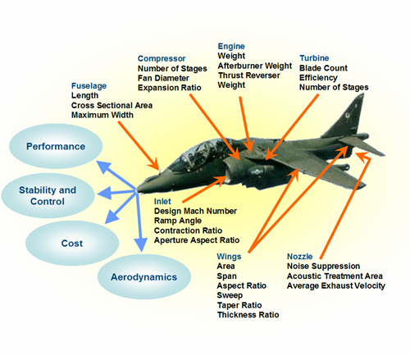
Emergent Properties
Properties associated with the system as a whole that cannot be attributed to a single subsystem

Slide 5
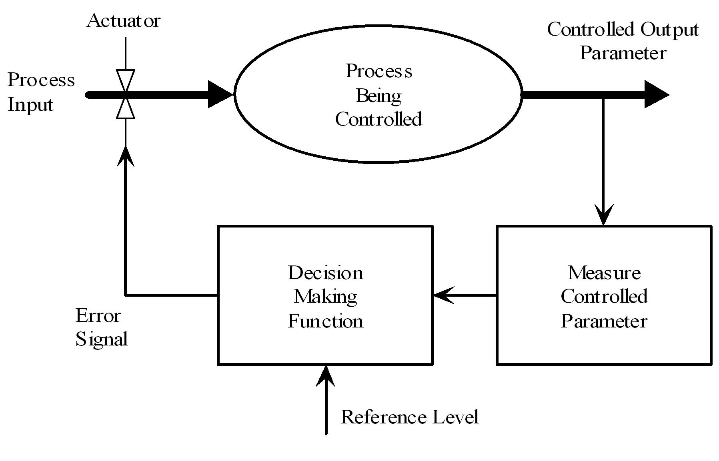
Feedback & Control

Slide 6
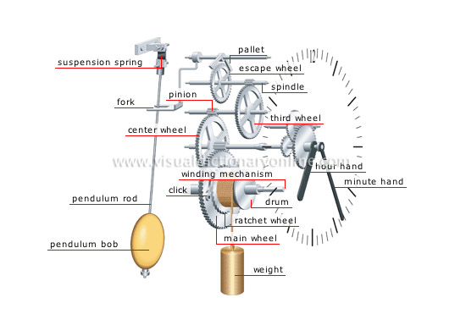
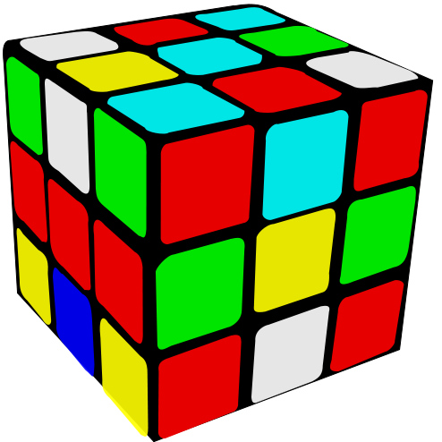
Complexity
Is complexity simply the large number of pieces a system has?
What about emergent behavior that cannot be predicted from system components?
Ability to understand?

Slide 7

Complexity
Complex Adaptive Systems – a system composed of independent agents, each with separate goals, that interact and exhibit emergent group behavior

Slide 8
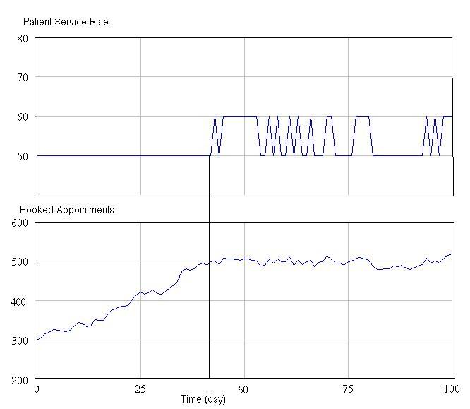
Dynamic

Slide 9
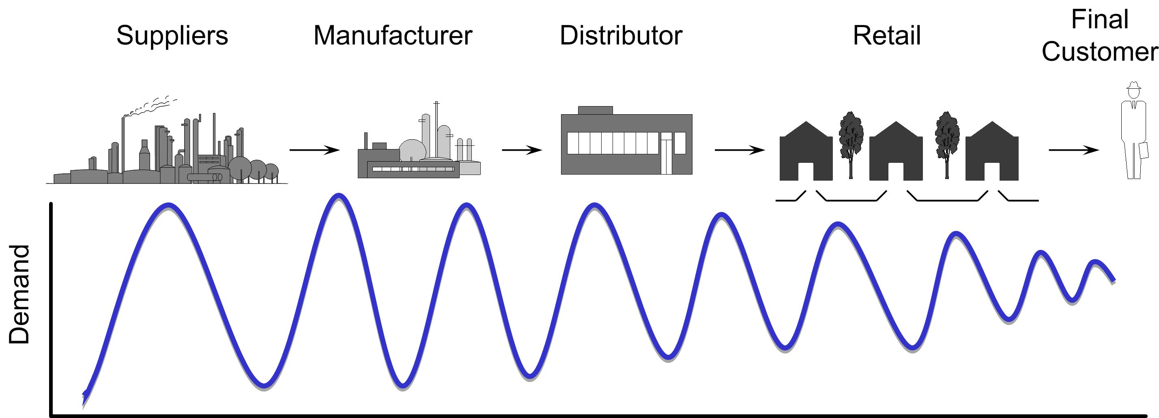
Dynamic
System changes over time
Open systems are self-regulating, they adjust to changes in their environment (human body maintains constant internal temperature regardless of outside temperature).

Slide 10
Equifinality
There are many combinations of inputs, outputs, transformation processes, and decisions that all lead to the same outcome

Slide 11

System Dynamics
A theory and a set of tools to study systems
Developed at MIT by Forrester
Combines computer simulation, control theory, and decision-making with systems theory
Two tools to support thinking:
  Causal Loop Diagrams
  Stock & Flow Diagrams with simulation

Slide 12
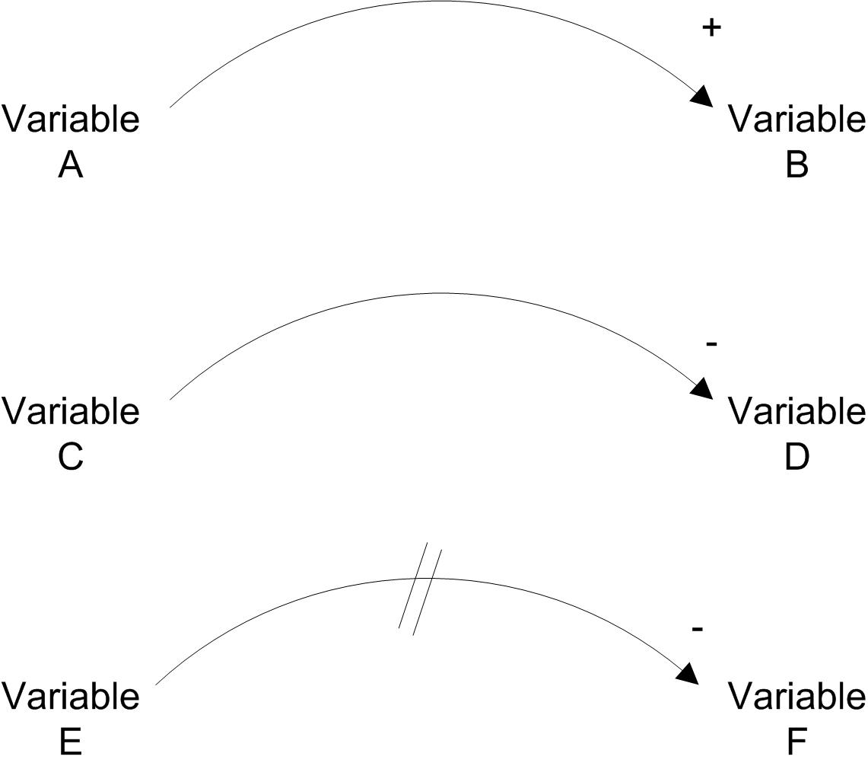
Causal Loop Diagrams
Depicts system as interrelated system of variables

Slide 13
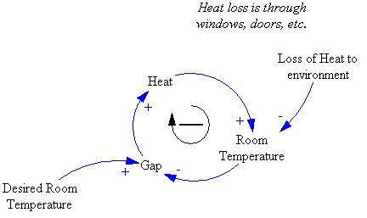
Feedback Loops
See Chapter 2 for how to identify the polarity of the loop

Slide 14
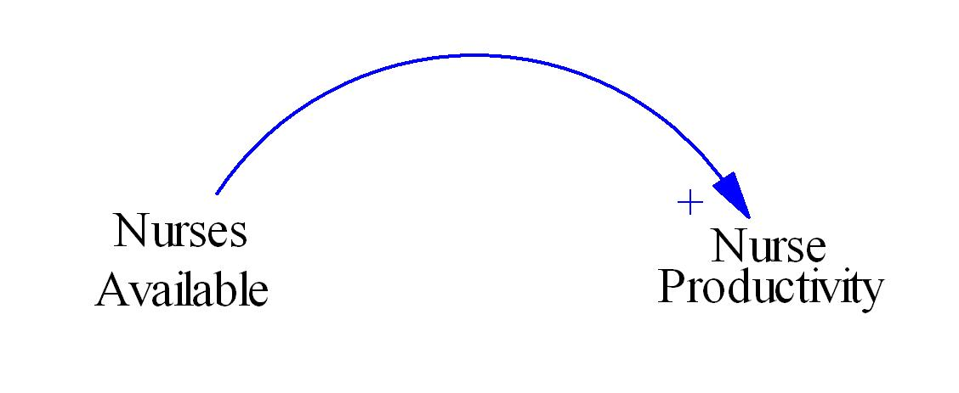
Example Causal Loop

Slide 15
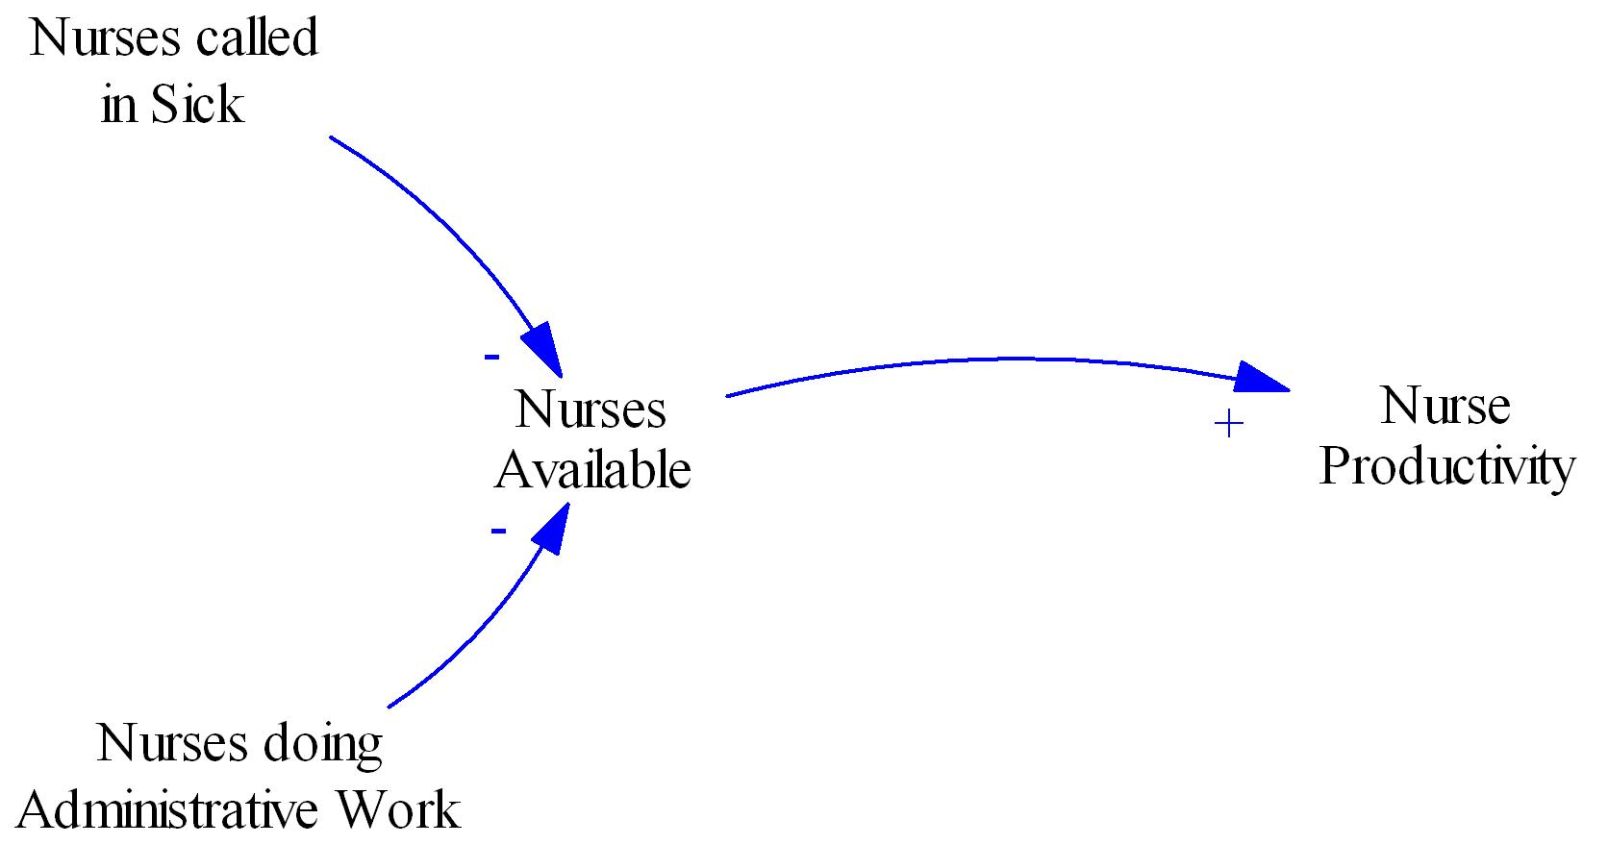

Slide 16
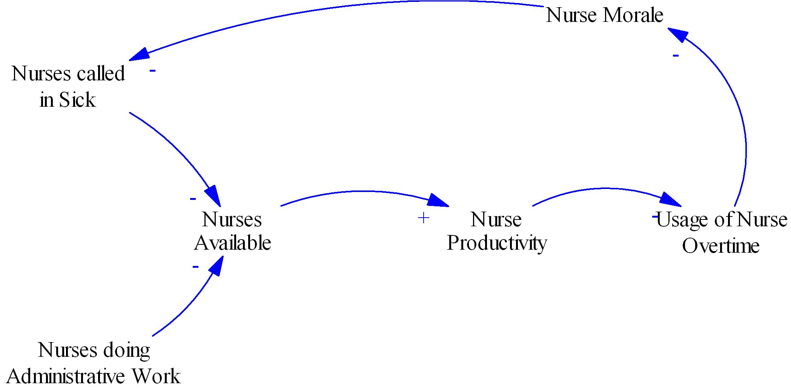

Slide 17
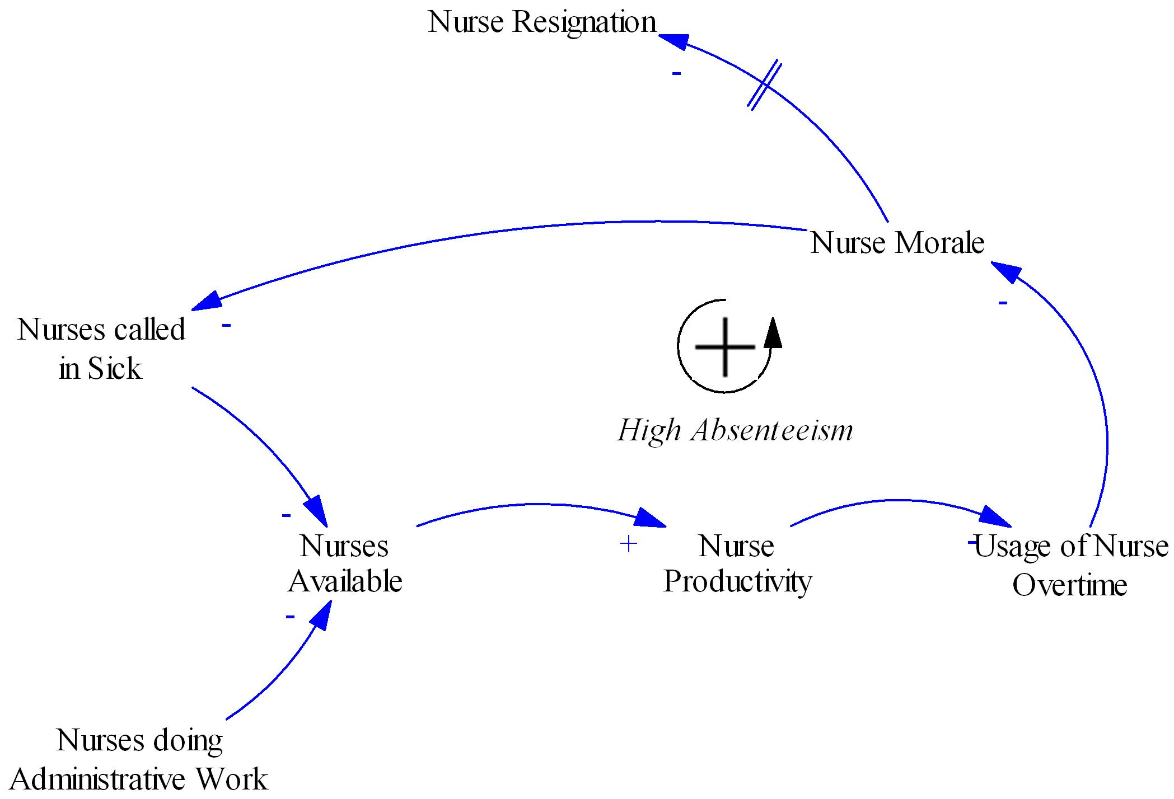

Slide 18
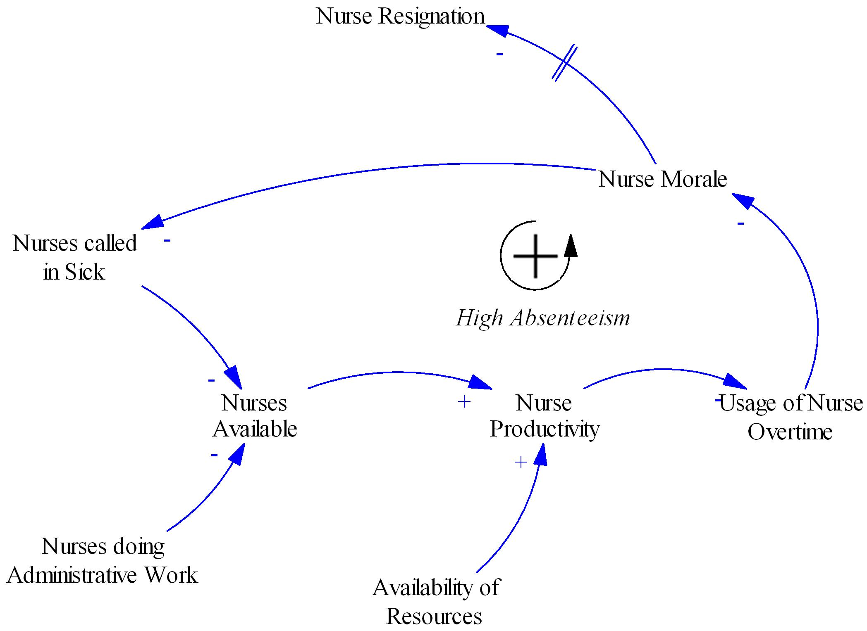

Slide 19
Causal Loop Adv/Dis
In a group, facilitates brainstorming and system understanding
Uncover all possible relationships
Uncover complexity
No analytical capabilities (qualitative)
Diagrams may not be valid – difficult to check

Slide 20
Stock & Flow Diagrams
The short-comings of causal loop diagrams is the inability to analyze the diagram
Stock & Flow are continuous simulation (think water flow through pipes)

Slide 21
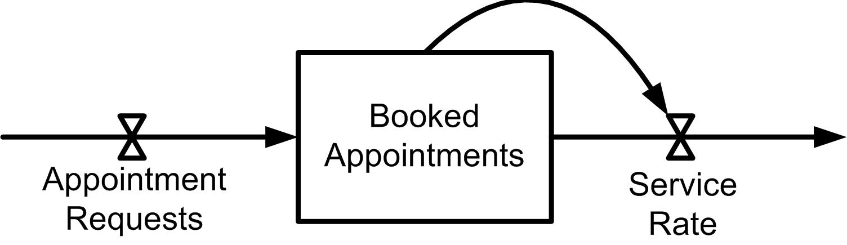
Stock & Flow illustrated
auxiliary relationship
Flow Variable
Stock Variable

Slide 22
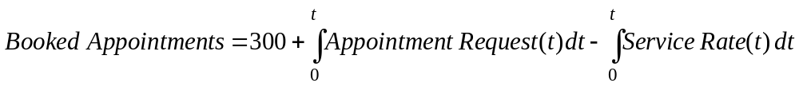
Stock & Flow Illustrated
See Chapter 2 for equations for flow rates

Slide 23
Simulation Results

Slide 24
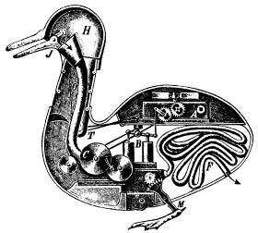
Reductionist Thinking
The idea that by decomposing a system we can understand how it works
Dominate form of thinking in engineering
Duck of Vaucanson

Slide 25
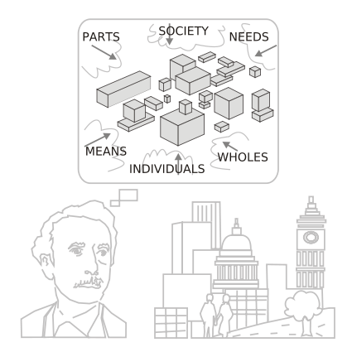
Systems Thinking
A way of thinking about enterprises that stresses the importance of relationships
A paradigm for thinking about the world
A language and set of definitions
A set of tools to understand systems

Slide 26
Summary
Define the enterprise boundaries that help best solve the problem.
Understand the system structure, identify its subsystems & parts.
Determine the stakeholders, their perspectives and their goals.
Remember there are many ways to achieve the goals (equifinality).
Understand the interaction with the environment (enterprises are open systems).
The enterprise has behavior that can be observed only at the enterprise level and cannot be deduced by analyzing subsystems of the enterprise in isolation.
To maintain stability in a changing environment the enterprise must adapt, which requires feedback loops from the environment.
Enterprises are purposeful systems because it can both choose its goals and its means to attain those goals. Additionally, the people in the enterprise are purposeful.
The enterprise is hierarchical, it is composed of lower-level subsystems, and the enterprise is part of higher-level systems (e.g., supply chains).
There are multiple ways to define the subsystems depending on the observers views (e.g., organizational subsystems, process subsystems, etc.).

